Slide 1

UNIVERSITY OF EDUCATION
-HCMc-

Slide 2
INTRODUCTION TO .NET TECHNOLOGY
ASP.Net Core 2.0 - MVCWebApp

Slide 3
Team Number:
Members:
Đàm Nhật Phong - Campus card no: 42.01.104.107
. Email: damnhatphong671998@gmail.com

Slide 4
E-MARKET WEBSITE

Slide 5

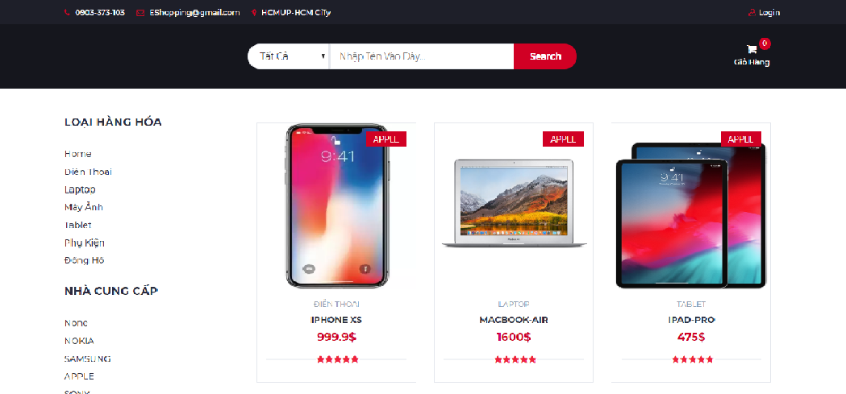
EMaket Website
-A simple website allows users to access and by electric stuff include phones, cameras, laptops, and some accessory
-Start With the a design of database will be shown below.

Slide 6
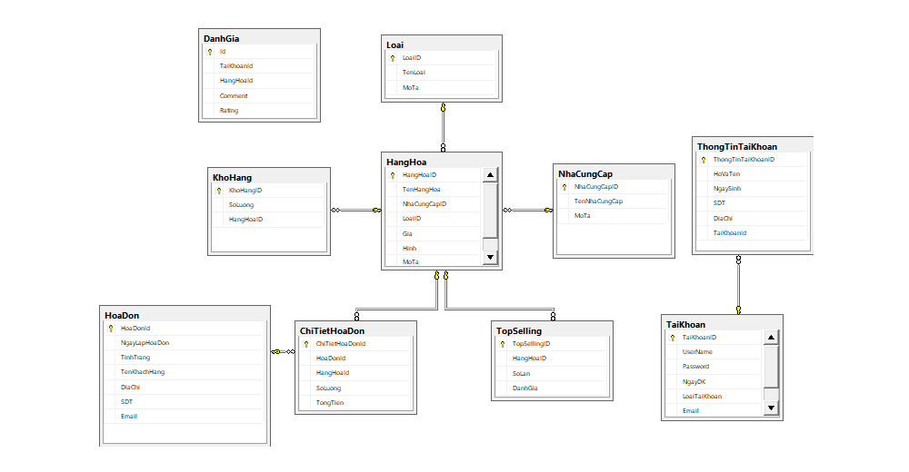
Database - Diagram

Slide 7
✦TABLES:
[HangHoa] table : represent the Products entity, having a specific category field and being supplied by one provider and.
[NhaCungCap] table : represent the Suppliers entity.
[Loai] table : represent the Categories entity.
[HoaDon] table : Invoice table, use to note down the bill state and bill content.
[ChiTietHoaDon] table : Invoice Details.
[KhoHang] table : Warehouse table, It lets us know how much left in the stock

Slide 8
✦ OTHER TABLES:
[DanhGia] table
[TopSelling] table
[ThongTinTaiKhoan] table
[TaiKhoan] table

Slide 9
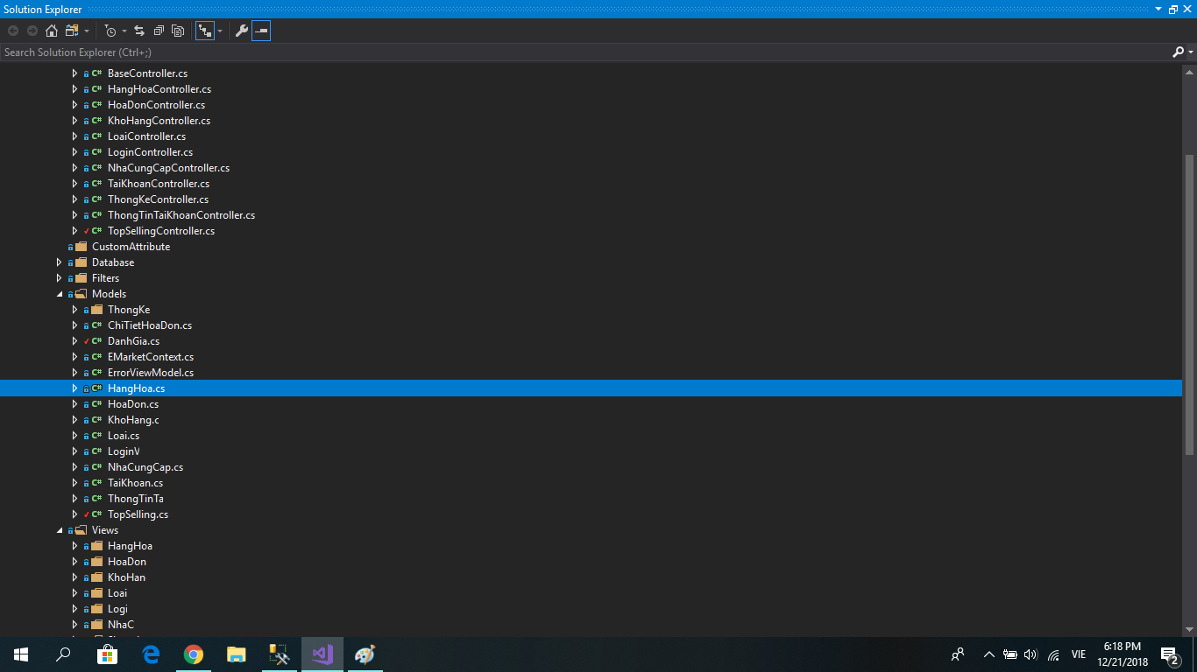
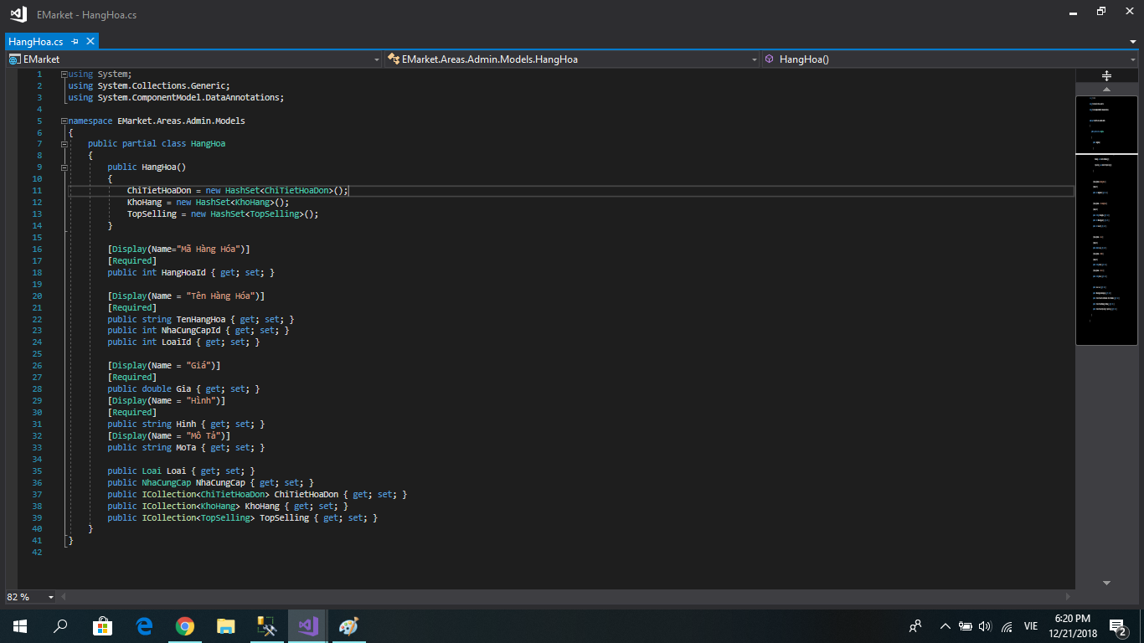

Slide 10

ADMIN
Admin role:
you would have a fully functional capability. Which you can do [insert-update-delete-retrieve] all the records belong to the data table except for the invoice part.
The App helps you to make reports and manage things such as commodities, suppliers, Category,...

Slide 11

Client
Client role:
You can go on this website and pick up something you liked. Search for some products.
Add products to a shopping cart and then click checkout to fill out your info to purchase that(those) products.

Slide 12
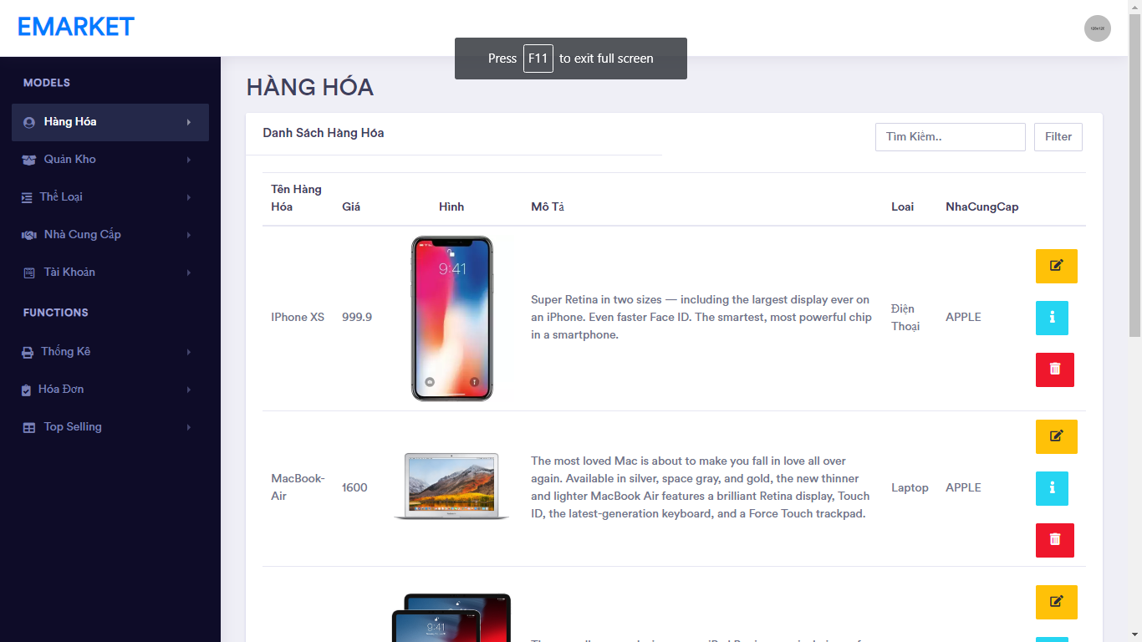

Slide 13
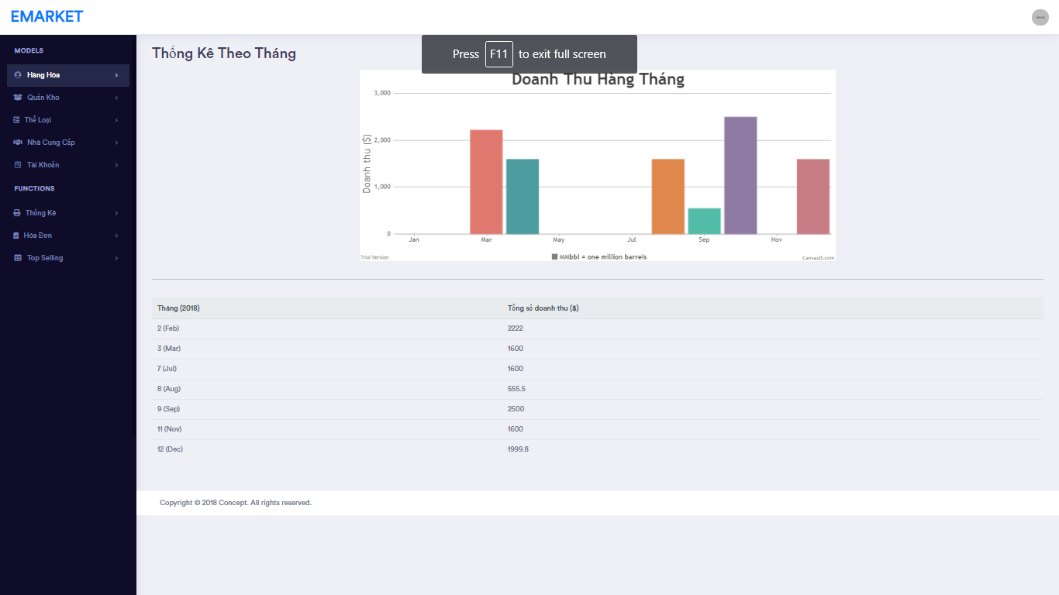

Slide 14
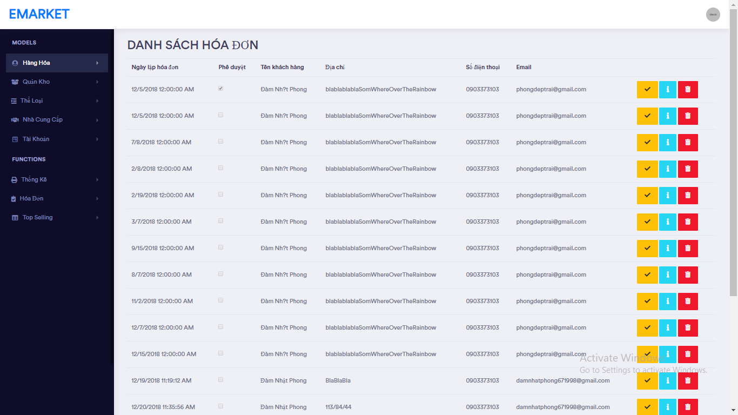

Slide 15
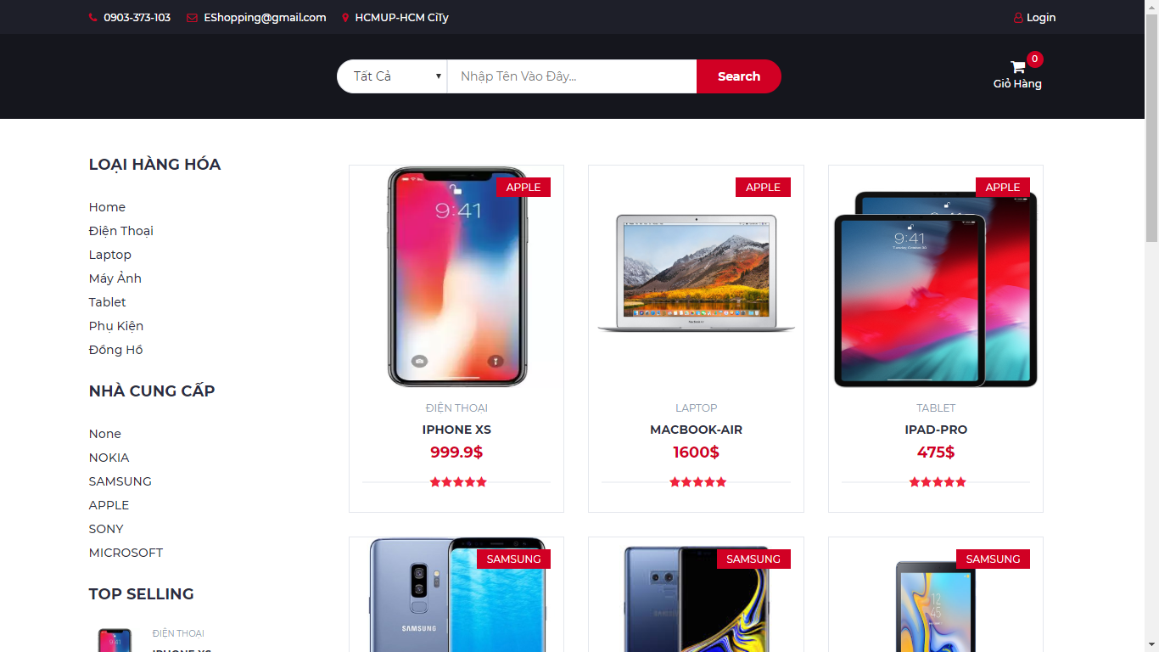

Slide 16
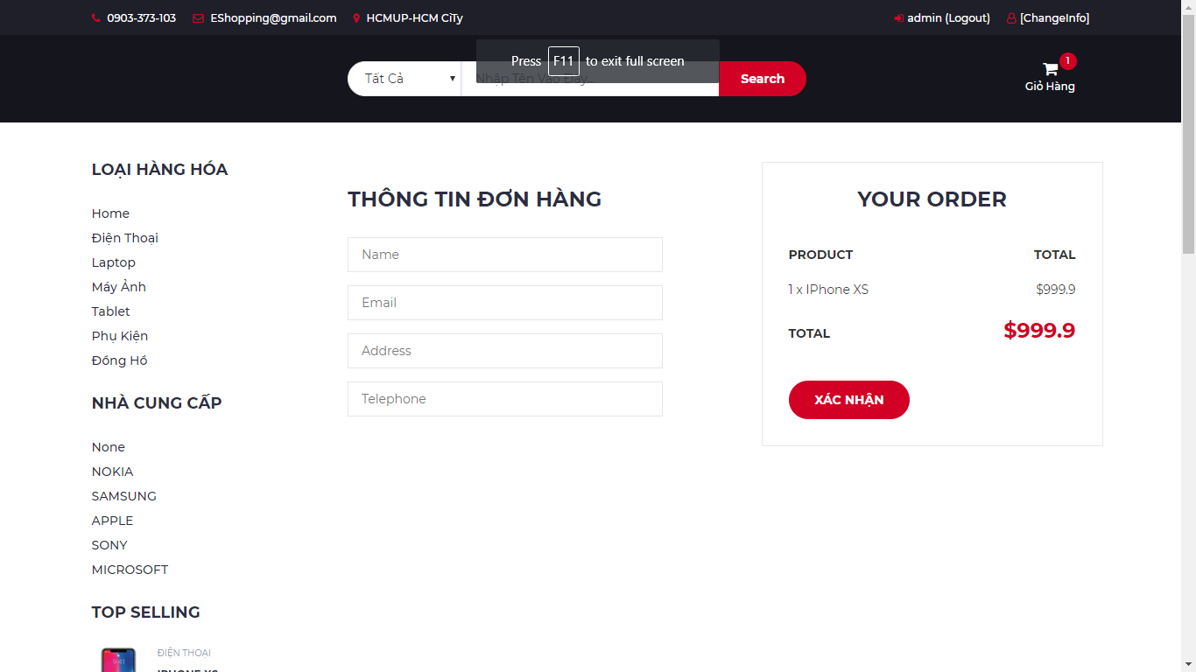

Slide 17
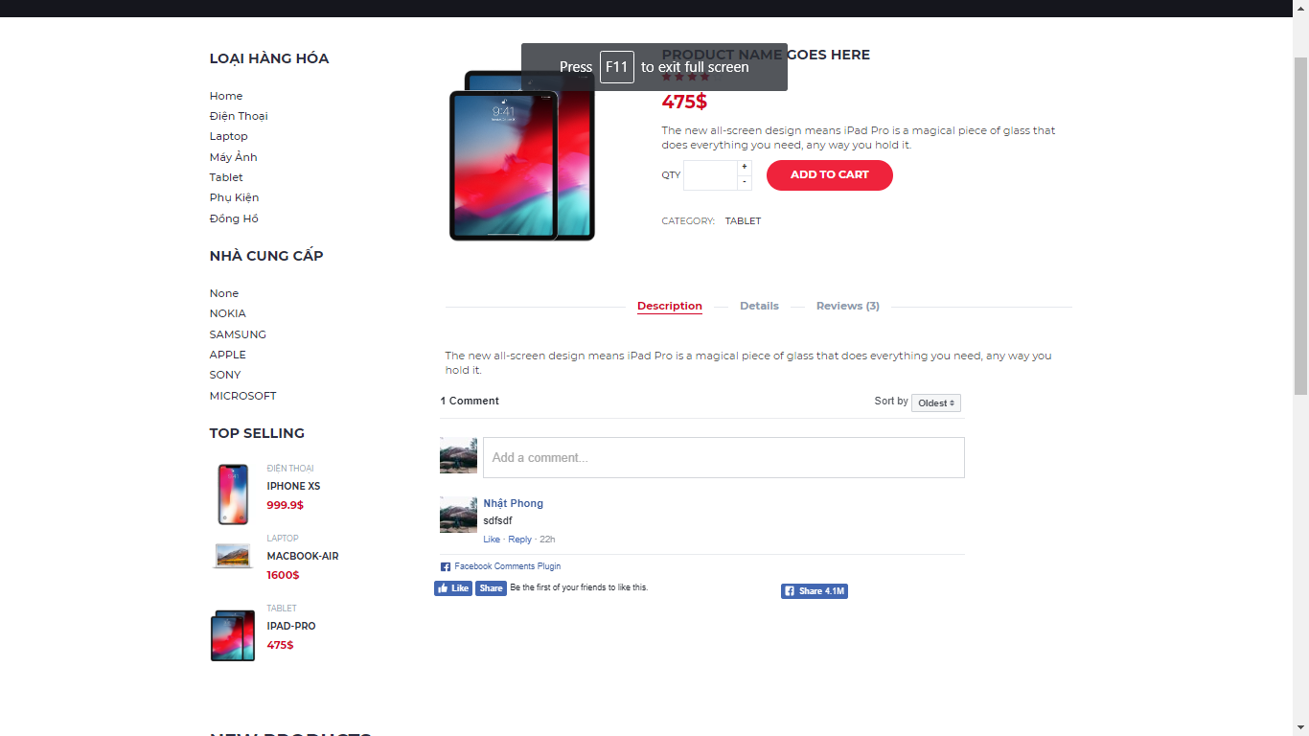

Slide 18
✦ Order Taking Process:
Customers must sign-in to place an order(Orders). And of course, the order must have at least one item in it.
Customers have to fill up the destination Requirements.
Customers wouldn’t be able to charge and buy those products that are currently unavailable.

Slide 19
✦ Functions :
Using web filter to search and filtering data.
Comment and rate
Customers wouldn’t be able to charge and buy those products that are currently unavailable.

Slide 20
DEMO
DEMO
DEMO
DEMO
DEMO

Slide 21
Have a nice Day!
GoodBye!

